Slide 1
UNIT-IV
INTRODUCTION TO GENETIC ALGORITHMS

Slide 2
Syllabus
Unit- I: Concept of computing systems, Introduction to soft computing, characteristics, applications of soft computing techniques.
Unit- II: Neural Networks: Biological Neural Network, Different ANNs architectures, Fundamentals, Neural Network Architectures, Feedforward Networks, training techniques in different ANNs, Applications of ANN to solve real world’s problems.
Unit- III: Fuzzy Logic: Introduction to Fuzzy logic, Fuzzy sets and membership functions, Operations on Fuzzy sets, Fuzzy relations, rules, propositions, implications and inferences, Defuzzification techniques, Fuzzy logic controller design, Some applications of Fuzzy logic.
Unit- IV: Genetic Algorithms: Concept of "Genetics" and "Evolution" and its application to probabilistic search techniques, Basic GA framework and different GA architectures, GA operators: Encoding, Crossover, Selection, Mutation, etc, Solving single-objective optimization problems using GAs.
Unit- V: Hybrid Systems: Genetic Algorithm based Backpropagation Network, Fuzzy – Backpropagation, Fuzzy Logic Controlled Genetic Algorithms. Case studies. Case studies in Engineering
Text Book:
Sinha, N.K. and Gupta, M. M.: “Soft Computing and Intelligent Systems - Theory and Applications”, Academic Press.
Neural Networks, Fuzzy Logic and Genetic Algorithms: Synthesis, and Applications, S. Rajasekaran, and G. A. Vijayalakshmi Pai, Prentice Hall of India, 2007.
Reference Books:
Soft Computing, D. K. Pratihar, Narosa, 2008.
Jang, J-S. R., Sun,C-T, Mizutani, E.: “Neuro–Fuzzy and Soft Computing”,

Slide 3
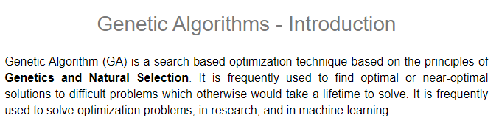

Slide 4
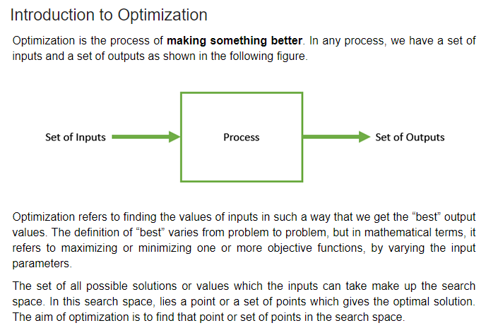

Slide 5
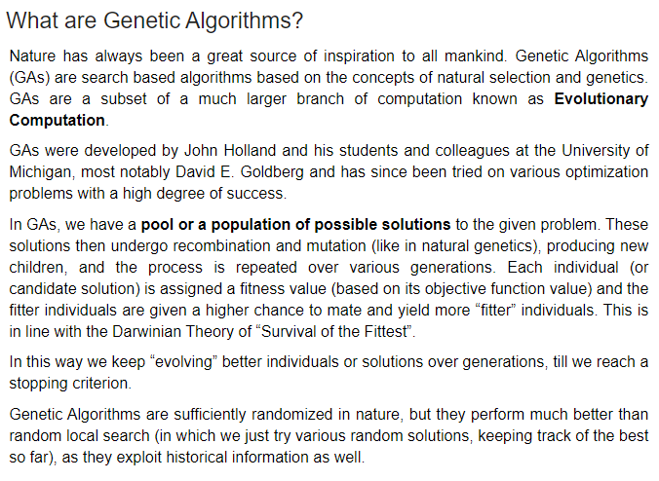

Slide 6
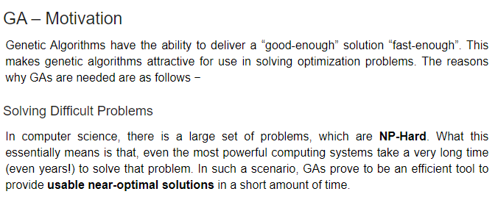

Slide 7
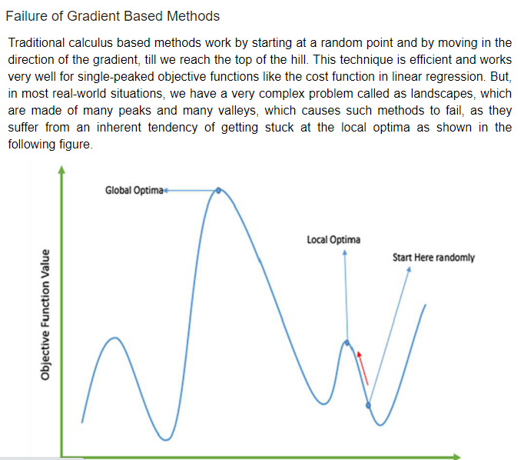

Slide 8
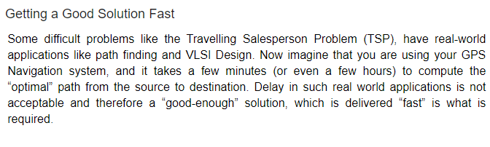

Slide 9
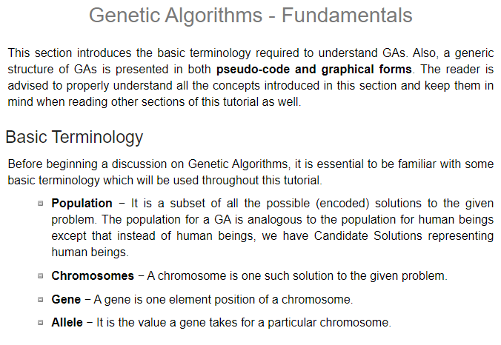

Slide 10
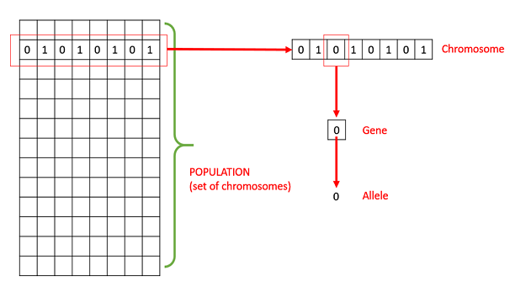

Slide 11
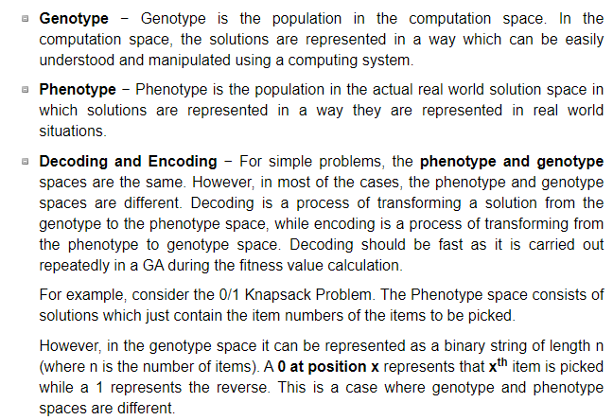

Slide 12
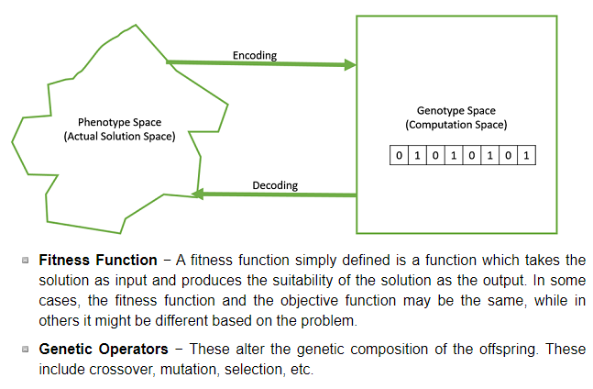

Slide 13
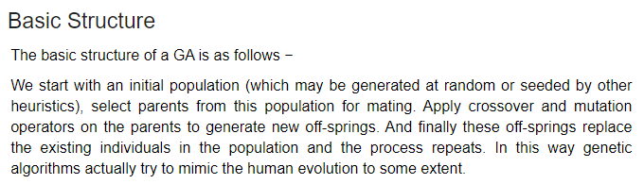

Slide 14
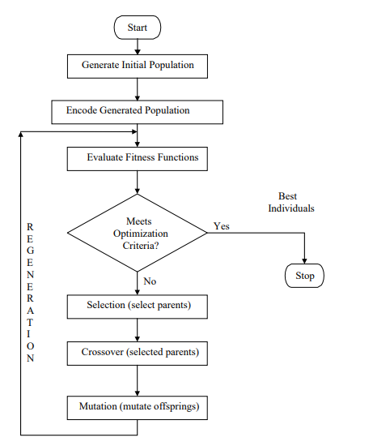

Slide 15
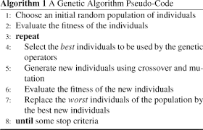

Slide 16
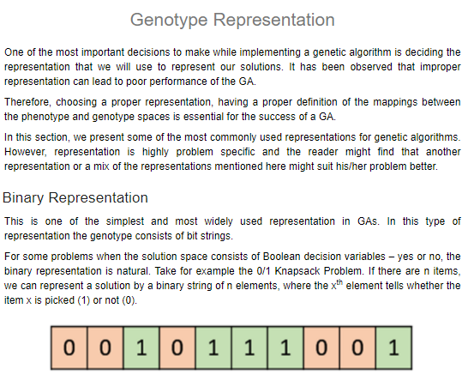

Slide 17
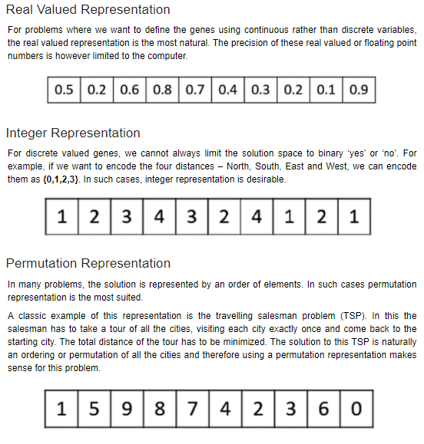

Slide 18
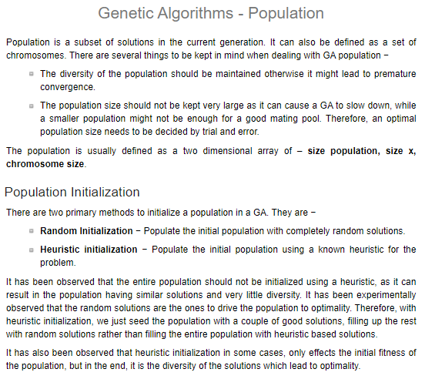

Slide 19
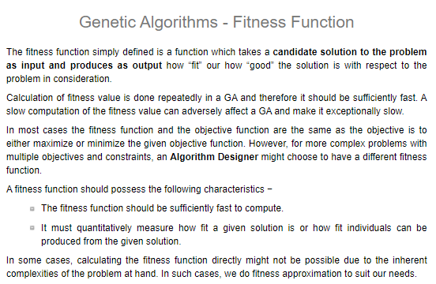

Slide 20
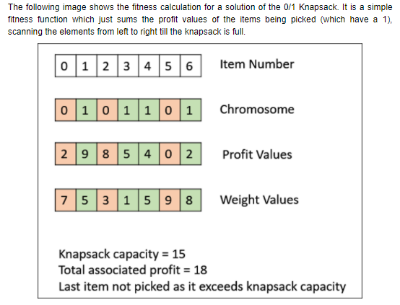

Slide 21
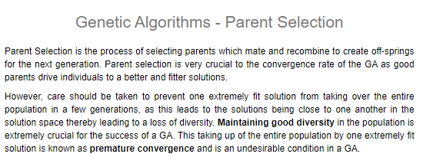

Slide 22
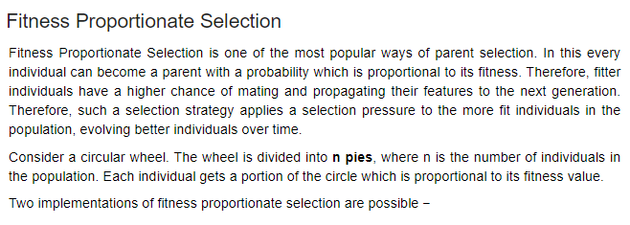

Slide 23
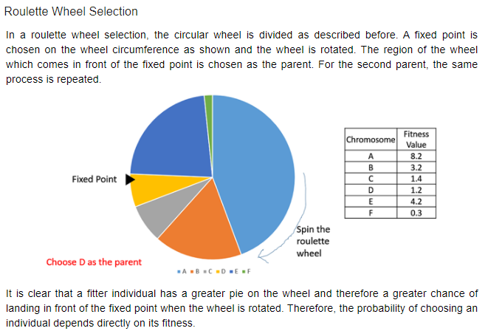

Slide 24
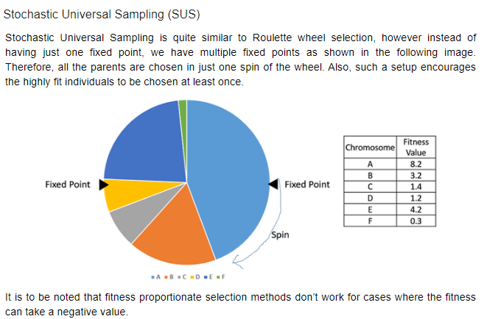

Slide 25
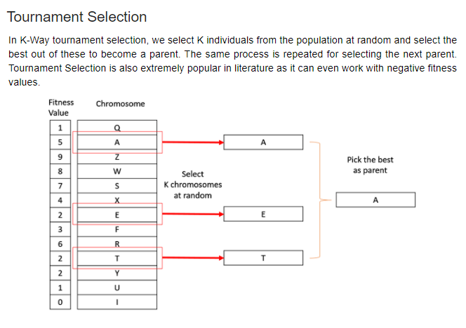

Slide 26
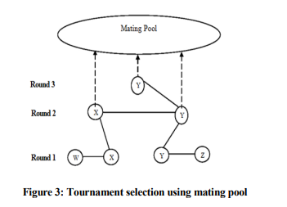

Slide 27
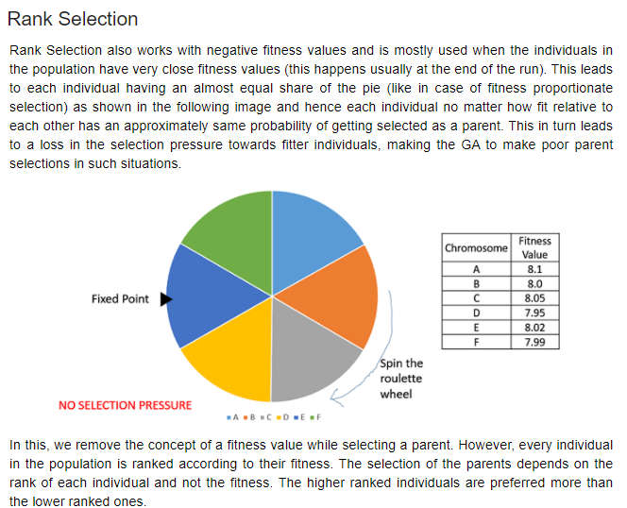

Slide 28
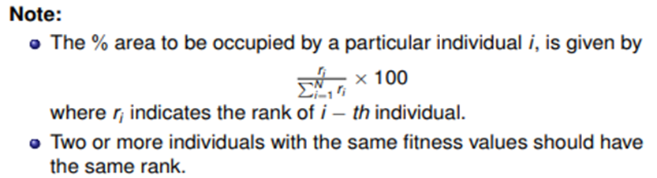
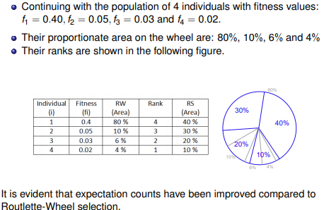

Slide 29
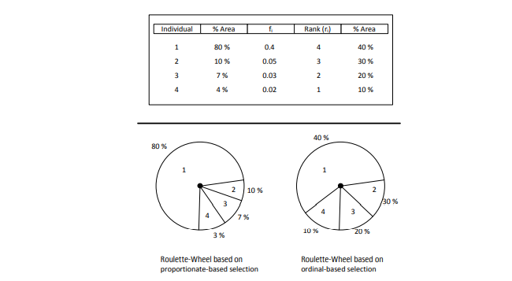
Comparison between Roulette-wheel selection and Rank-based selection

Slide 30
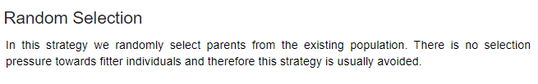
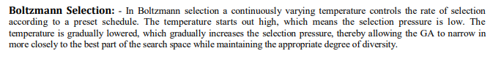
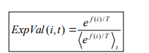

Slide 31
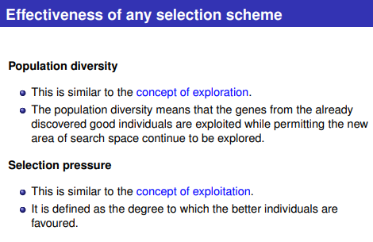
Effectiveness of any selection scheme

Slide 32
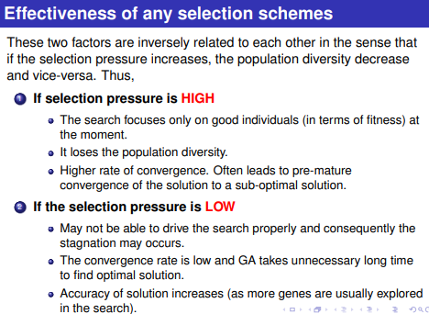
Effectiveness of any selection scheme

Slide 33
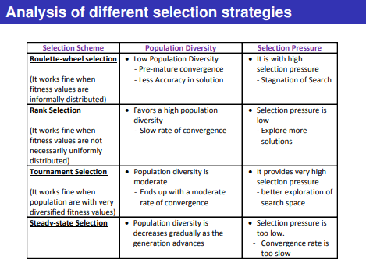
Analysis of different selection strategies

Slide 34
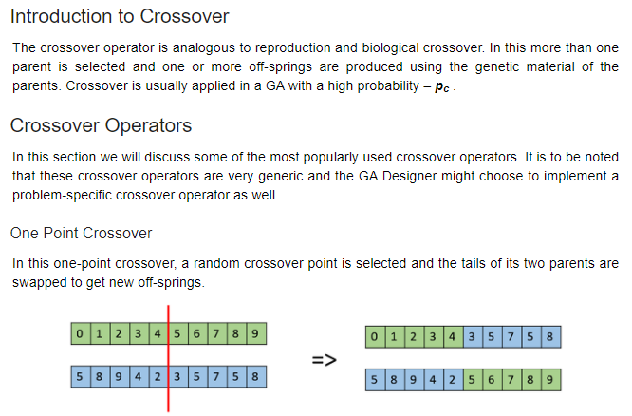

Slide 35
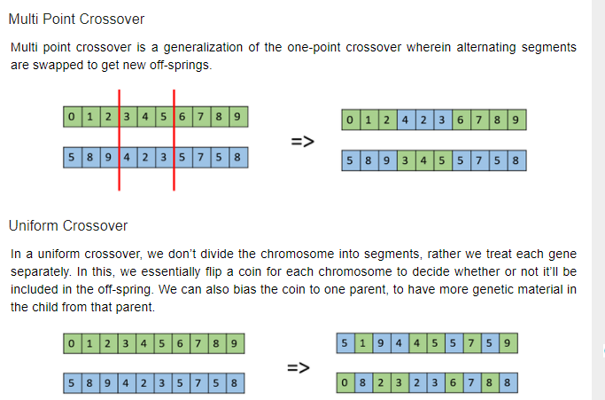

Slide 36
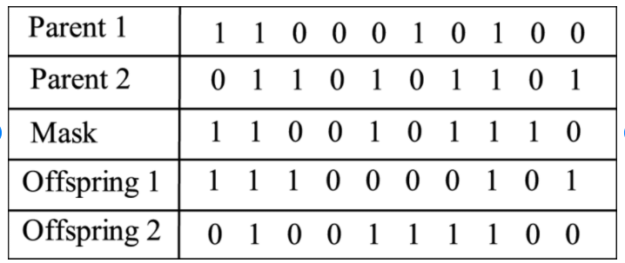

Slide 37
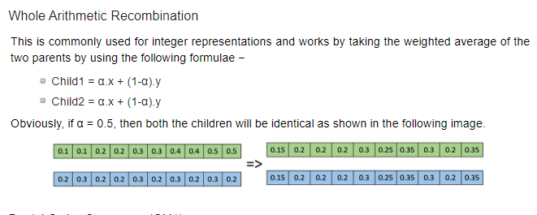

Slide 38
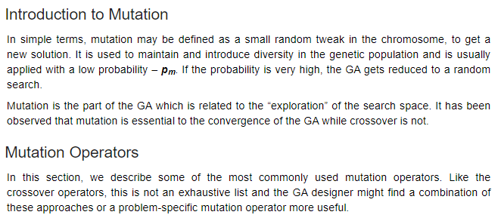

Slide 39
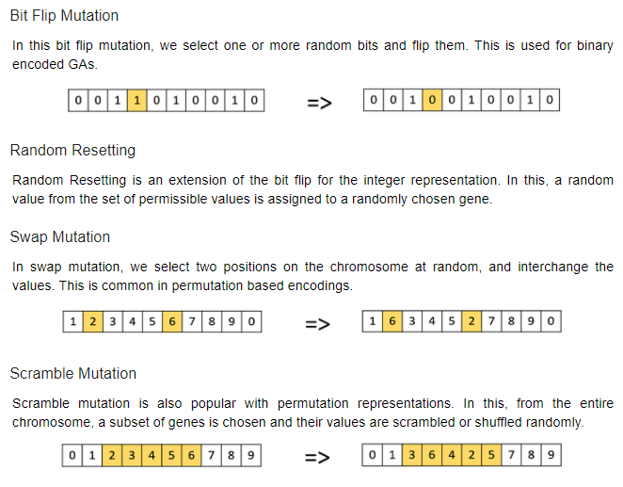

Slide 40
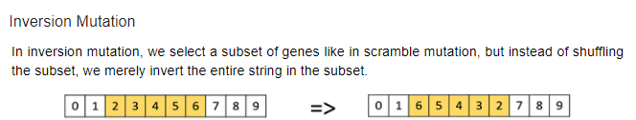

Slide 41
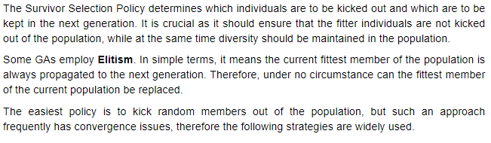
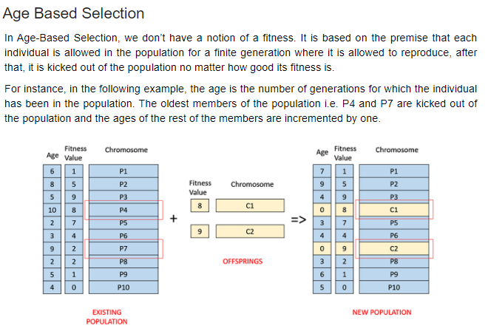

Slide 42
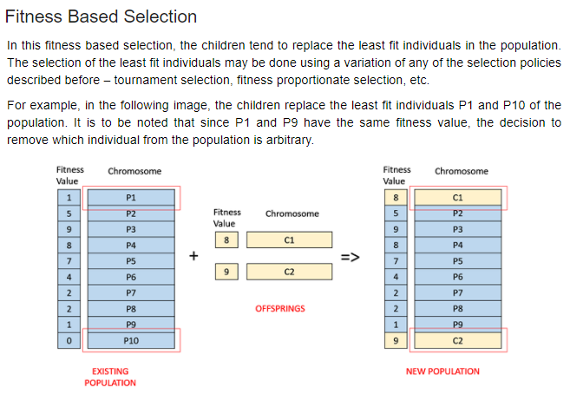

Slide 43
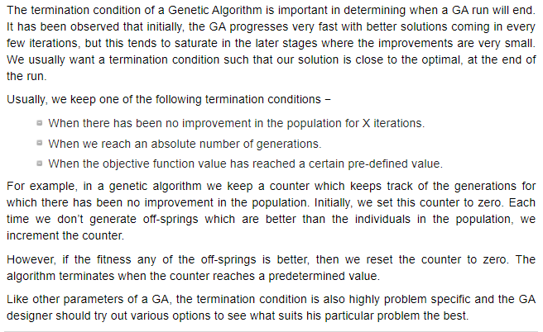
Termination

Slide 44
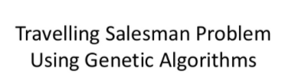

Slide 45
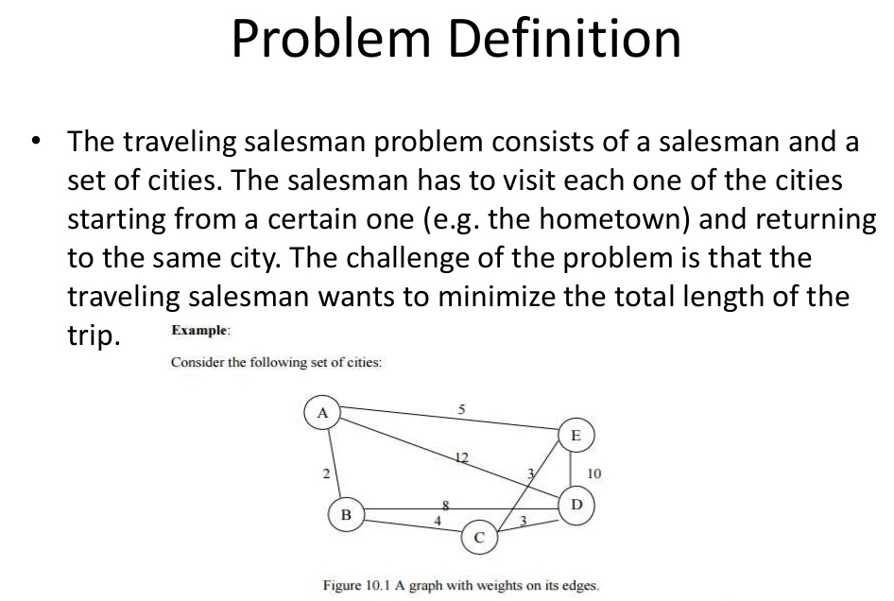

Slide 46
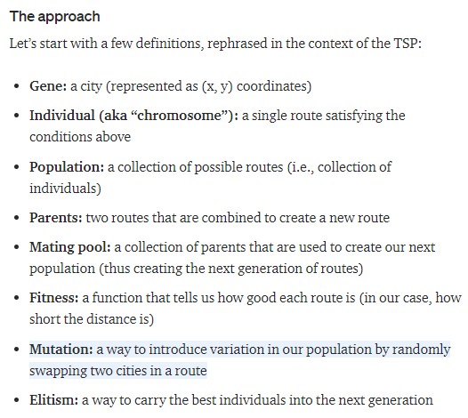

Slide 47
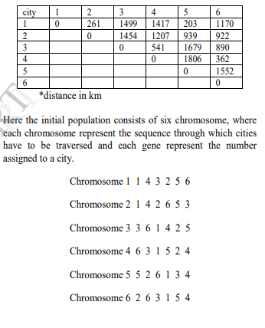
Example

Slide 48
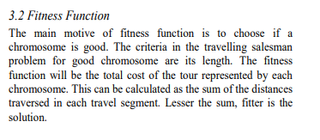

Slide 49



Slide 50


Slide 51


Slide 52
Unit-V Hybrid Systems

Slide 53


Slide 54


Slide 55


Slide 56


Slide 57


Slide 58


Slide 59



Slide 60


Slide 61



Slide 62


Slide 63


Slide 64


Slide 65


Slide 66


Slide 67


Slide 68


Slide 69


Slide 70


Slide 71


Slide 72


Slide 73


Slide 74


Slide 75


Slide 76


Slide 77


Slide 78


Slide 79
Working flow:
In input layer, each neuron transmits external crisp signals directly to the next layer.
Each fuzzification neuron receives a crisp input and determines the degree to which the input belongs to input fuzzy set.
Fuzzy rule layer receives neurons that represent fuzzy sets.
An output neuron, combines all inputs using fuzzy operation UNION.
Each defuzzification neuron represents single output of neuro-fuzzy system

Slide 80


Slide 81


Slide 82


Slide 83


Slide 84


Slide 85


Slide 86


Slide 87


Slide 88


Slide 89


Slide 90


